Slide 1
Generating employee digital experience certificate using SAP Script By: CSE-D Team-1

Slide 2
ABSTRACT
INTRODUCTION TO SAP
WHAT IS ABAP?
TRANSACTION CODE
SOME OF THE TRANSACTION CODES USED
INTERNAL TABLE CONCEPT
SAMPLE CODE
WINDOWS USED
ABOUT WINDOWS
SOURCE CODE
OUTPUT SCREENS

Slide 3
ABSTRACT
Present systems, like traditional paper based certificate generation system has some disadvantages like Inaccessibility, Lower Quality , Limited Flexibility, Lengthy Process, High Cost, Non Eco-Friendly. SAP script is the SAP System's own text-processing system . A printed form or certificate that you need for internal use or which you want to send to a customer or vendor,another format like, be an internal electronic mail message that you want to send to anyone for future use. Scope is not limited cannot be crashed easily. Because of many advantages we are using SAP Scripting technology for better quality certificates generation.

Slide 4
INTRODUCTION TO SAP
SAP stands for Systems, Applications, Products in data processing.
SAP Software was founded in 1972.
SAP is well known for its ERP(Enterprise Resource Planning) and data management programs.
SAP system consists of a number of fully integrated modules, which covers every aspect of business management.

Slide 5
WHAT IS ABAP?
ABAP stands for Advanced Business Application Programming.
It was developed in 1980’s.
ABAP is a high-level programming used for programming in SAP.
Customers can develop custom reports, forms, interfaces, procedures using ABAP Programming.

Slide 6
TRANSACTION CODE(t-code)
A transaction code is used to go to any task in SAP application faster.
It can consists of letters, numbers or both.
By entering a transaction code instead of using the menu, you can go to a task and start the function in a single step.

Slide 7
SOME OF THE TRANSACTION CODES USED
SE11-ABAP Dictionary.
SE38-ABAP Editor.
SE21-Creating package.
SE80-Object Navigator.
SE93-Creating customized transaction code.
SE16N-To check table’s content.
SE71-To create forms.

Slide 8
INTERNAL TABLE CONCEPT
Internal Table provides a means of taking data from a fixed structure and storing it in a working memory.
The data is stored line by line in memory and each line has the same structure.
In ABAP, Internal Tables fulfill the function of arrays.

Slide 9
SAMPLE CODE
TABLES : ZCSE_C.
DATA : BEGIN OF ITAB OCCURS 0,
S_ID TYPE ZCSE_C-S_ID,
S_NAME TYPE ZCSE_C-S_NAME,
END OF ITAB.
SELECT * FROM ZCSE_C INTO ITAB.
APPEND ITAB TO ITAB[].
ENDSELECT.
LOOP AT ITAB[] INTO ITAB.
WRITE:/ITAB-S_ID COLOR 3, ITAB-S_NAME COLOR 4.
ENDLOOP.

Slide 10
WINDOWS USED
Following are the windows used in project:
MAIN Window
LOGO Window
ADDRESS Window
SIGNATURE Window
CUSTOMER Window

Slide 11
ABOUT WINDOWS
MAIN WINDOW:
In this window a table with few columns of given sales order number will be displayed.
LOGO WINDOW:
This window is used for displaying logo.
Download image of type “.bmp”.
Navigation:
SE78->import->select path(where the logo is present->select color image->select OK.
click on transport symbol and click OK.

Slide 12
ABOUT WINDOWS
CUSTOMER WINDOW:
This window is used for displaying customer details like
ID , NAME , DOJ , DOB , DESIGNATION.
ADDRESS WINDOW:
In this window we display address.
SIGNATURE WINDOW:
In this window we display signature.

Slide 13
SOURCE CODE
REPORT ZEMPLOYEE_EXP_LETTER.
TABLES: ZEMP_EXP_DETAILS.
DATA: BEGIN OF IT_ITAB,
ID TYPE ZEID,
NAME TYPE ZNAME1,
DOJ TYPE ZDOJ,
DOB TYPE ZDOB,
DESIGNATION TYPE ZDESIGNATION,
END OF IT_ITAB.
DATA: WA1_EMP_EXP LIKE IT_ITAB,
ITAB_EMP_EXP LIKE TABLE OF IT_ITAB.
DATA: V_SPOOL TYPE ITCPP.

Slide 14
SOURCE CODE
SELECTION-SCREEN BEGIN OF BLOCK B1 WITH FRAME TITLE TEXT-001.
SELECT-OPTIONS: EMP_ID FOR IT_ITAB-ID.
SELECTION-SCREEN END OF BLOCK B1.
AT NEW ID.
PERFORM START_FORM.
PERFORM WRITE_FORM_ADDRESS.
PERFORM WRITE_FORM_LOGO.
PERFORM WRITE_FORM_PRINT_MAIN.
PERFORM WRITE_FORM_SIGNATURE.
PERFORM END_FORM.
ENDAT.
ENDLOOP.
PERFORM CLOSE_FROM.

Slide 15
SOURCE CODE
AT NEW ID.
PERFORM START_FORM.
PERFORM WRITE_FORM_ADDRESS.
PERFORM WRITE_FORM_LOGO.
PERFORM WRITE_FORM_PRINT_MAIN.
PERFORM WRITE_FORM_SIGNATURE.
PERFORM END_FORM.
ENDAT.
ENDLOOP.
PERFORM CLOSE_FROM.

Slide 16
SOURCE CODE
FORM READ_EMP_EXP_DATA .
SELECT ID NAME DOJ DOB DESIGNATION INTO TABLE ITAB_EMP_EXP
FROM ZEMP_EXP_DETAILS WHERE ID IN EMP_ID.
ENDSELECT.

Slide 17
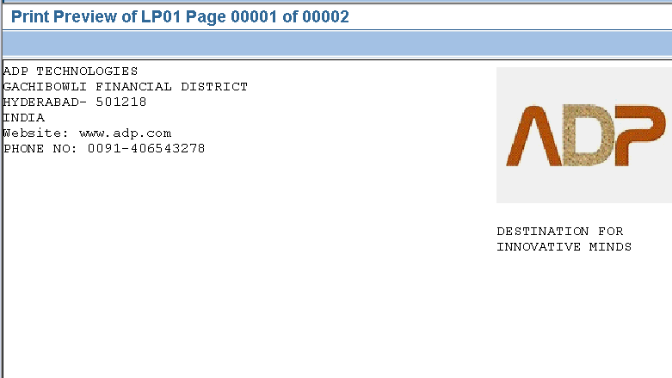
Output Screens Address & Logo Window

Slide 18
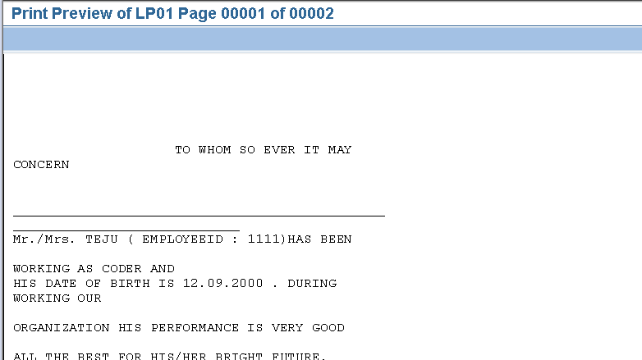
Output screen- Customer Window

Slide 19
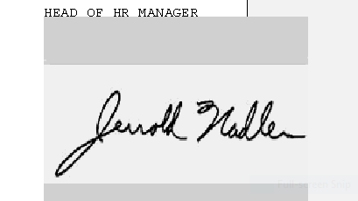
Signature Window

Slide 20


